Slide 1
MGMT-6064 PROJECT LEADERSHIP AND MANAGEMENT
Module 3: Culture and Project Management

Slide 2

Objectives
Definition of culture
Cultural artifacts
Weak & strong culture
Dominant & sub-cultures
Who creates organizational culture?
Competing Values Framework (cultural assessment model)
Managing culture on your project team
Notes:
Image: https://www.centranum.com/wp-content/uploads/2015/09/organization-culture.png

Slide 3
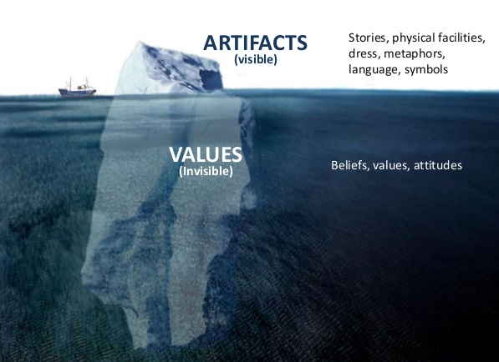
Organization Culture
Values and assumptions shared within an organization
The “personality” of the organization (and how it is expressed)
(Video)
Notes:
Image Source: https://image.slidesharecdn.com/organizational-culture-130520004350-phpapp02/95/organizational-culture-3-638.jpg?cb=1369017224
Content Source: McShane, S.L. & Sheen, S. (2009). Canadian organizational behaviour (7th ed.). Toronto: McGraw-Hill Ryerson.

Slide 4

Culture: shared Values and assumptions
Shared values: commonly-held conscious beliefs that guide the preferences & actions of people
Espoused (core) values: values that organizations/leaders say that are important and that they rely on
Enacted values: values that organizations/leaders actually rely on
Shared assumptions: unconscious perceptions or beliefs that are considered the correct way to think and act towards problems and opportunities
Notes:
Content Source: McShane, S.L. & Sheen, S. (2009). Canadian organizational behaviour (7th ed.). Toronto: McGraw-Hill Ryerson.
Image: http://sueschade.com/wp-content/uploads/2016/01/Values-Compass.jpg

Slide 5

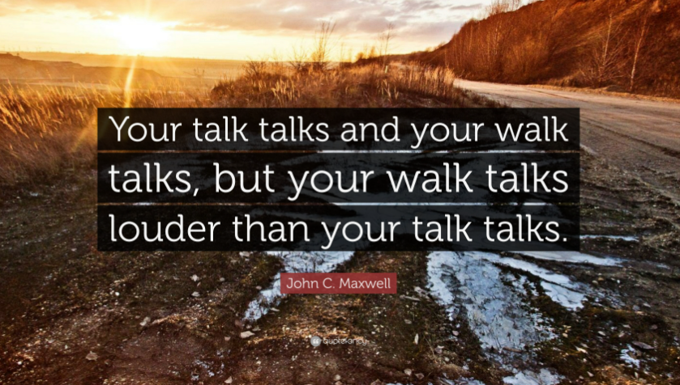
espoused versus enacted values
Notes:
Content Source: McShane, S.L. & Sheen, S. (2009). Canadian organizational behaviour (7th ed.). Toronto: McGraw-Hill Ryerson.
Image: http://sueschade.com/wp-content/uploads/2016/01/Values-Compass.jpg

Slide 6
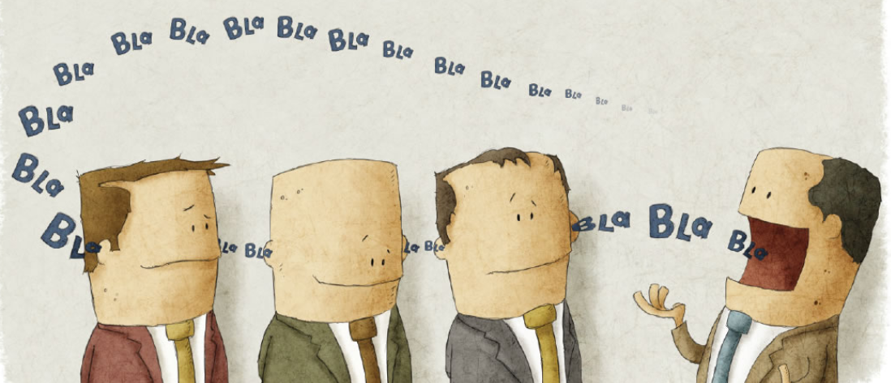
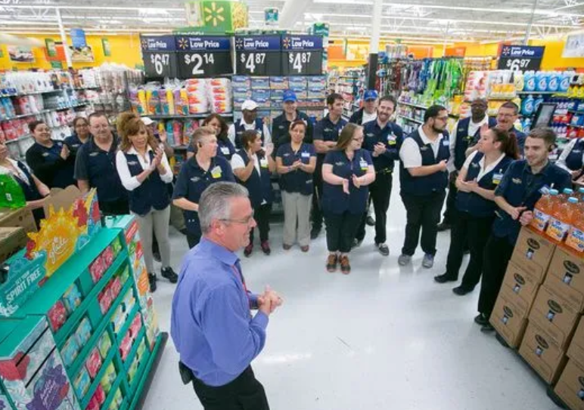
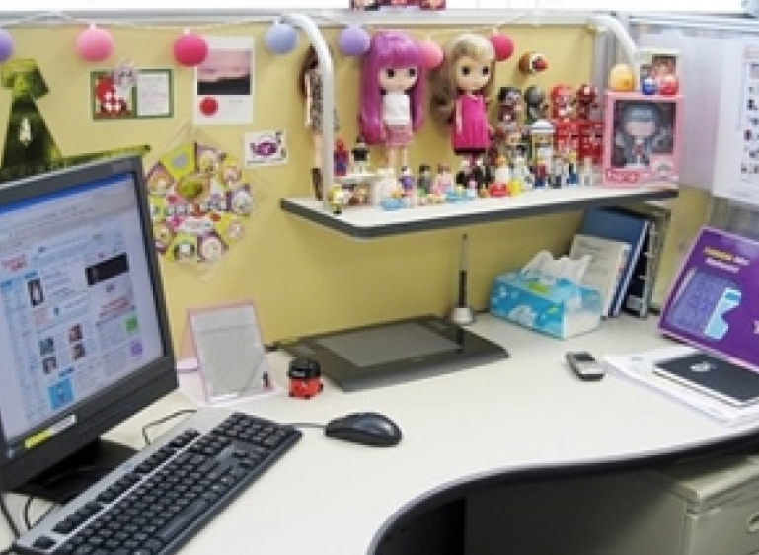

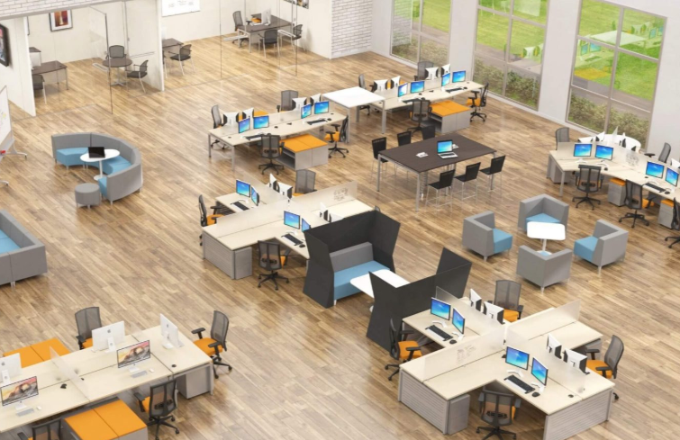
Cultural artifacts
Artifacts: observable symbols and signs of an organization’s culture
Stories and legends
Rituals and ceremonies
Language
Physical structures and symbols
Etc.
Notes:
Content Source: McShane, S.L. & Sheen, S. (2009). Canadian organizational behaviour (7th ed.). Toronto: McGraw-Hill Ryerson.
Images:
https://www.rootinc.com/wp-content/uploads/2017/08/every-company-has-story.jpg
http://www.gannett-cdn.com/-mm-/b0b9d5da73f5fa5fd6a2f79bcf56f54c553b1c0d/c%3D136-0-2319-1637%26r%3Dx404%26c%3D534x401/local/-/media/Phoenix/2015/03/15/B9316555640Z.1_20150315095237_000_GOBA7A043.1-0.jpg
http://www.suncityvillas.com/size/1024x768/server13-cdn/2016/08/12/work-office-cubicle-decorating-ideas-office-cubicle-design-ideas-b889187d7f1cf3c0.jpg
http://i.huffpost.com/gen/1231461/thumbs/o-WORKERS-facebook.jpg
https://structen.net/wp-content/uploads/2018/03/open-office-design.jpg

Slide 7





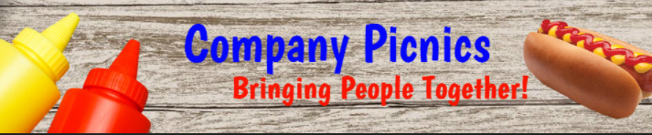
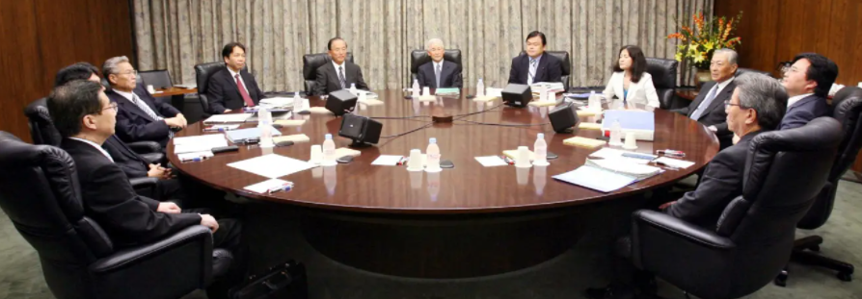
cultural artifacts
Notes:
Content Source: McShane, S.L. & Sheen, S. (2009). Canadian organizational behaviour (7th ed.). Toronto: McGraw-Hill Ryerson.
Images:
https://www.rootinc.com/wp-content/uploads/2017/08/every-company-has-story.jpg
http://www.gannett-cdn.com/-mm-/b0b9d5da73f5fa5fd6a2f79bcf56f54c553b1c0d/c%3D136-0-2319-1637%26r%3Dx404%26c%3D534x401/local/-/media/Phoenix/2015/03/15/B9316555640Z.1_20150315095237_000_GOBA7A043.1-0.jpg
http://www.suncityvillas.com/size/1024x768/server13-cdn/2016/08/12/work-office-cubicle-decorating-ideas-office-cubicle-design-ideas-b889187d7f1cf3c0.jpg
http://i.huffpost.com/gen/1231461/thumbs/o-WORKERS-facebook.jpg
https://structen.net/wp-content/uploads/2018/03/open-office-design.jpg

Slide 8

Who creates organizational culture?
Company founders are key cultural architects
Managers and leaders are role models – they influence culture (whether they want to or not)
Employees shape culture when there’s a ‘leadership vacuum’
Notes:
Image: https://banner2.kisspng.com/20180414/yre/kisspng-social-media-influencer-marketing-digital-marketin-social-icons-5ad26cf41e3bb5.4328570715237398921239.jpg

Slide 9
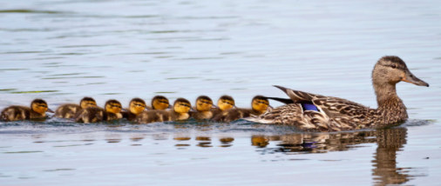


As a project manager, you shape culture (whether you want to or not)
Notes:
Image: https://banner2.kisspng.com/20180414/yre/kisspng-social-media-influencer-marketing-digital-marketin-social-icons-5ad26cf41e3bb5.4328570715237398921239.jpg

Slide 10
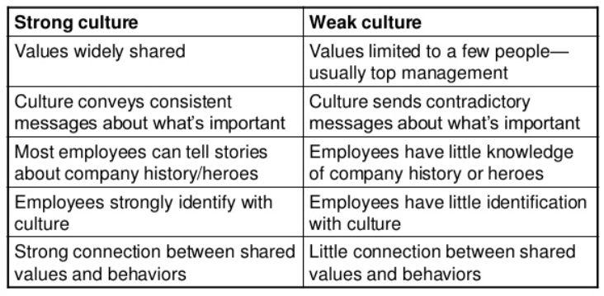
Strong & weak culture
Notes:
Source: https://image.slidesharecdn.com/organizationalcultureandenvironmenttheconstraints-130723194806-phpapp02/95/organizational-culture-and-environment-the-constraints-4-638.jpg?cb=1374608959

Slide 11

Strong culture
Strong and healthy culture enhances success:
People know what to expect, why things happen, and how to interpret words/actions from managers (sense-making)
People know how they should behave (control)
People feel like they’re part of a team or family (fulfills a need for social identity)
But… If culture is TOO strong, it might become too rigid, difficult to change, and it might lead to groupthink (potential opportunities are ignored, different viewpoints or opinions are discouraged)
Notes:
Content Source: McShane, S.L. & Sheen, S. (2009). Canadian organizational behaviour (7th ed.). Toronto: McGraw-Hill Ryerson.
Image: http://news.blr.com/app/uploads/sites/3/2013/02/Strong-Culture.jpg

Slide 12
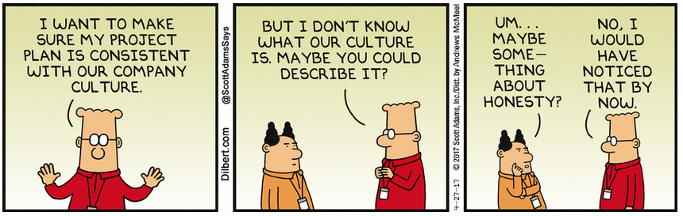
weak culture
Notes:
Image: https://assets.amuniversal.com/0322fa00002f01358a9d005056a9545d

Slide 13
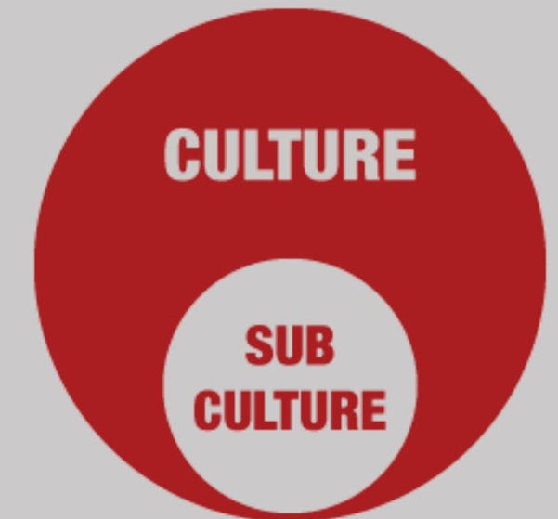
Dominant culture & Subcultures
Dominant Culture: values & assumptions shared most widely by the organization’s members
Subculture: distinct cultural values & assumptions that are shared within groups, project teams, departments, occupations
Subcultures may be (somewhat or mostly) aligned with the dominant culture, but may be very different
Organizations with weak cultures may have many subcultures but no dominant culture
Notes:
Content Source: McShane, S.L. & Sheen, S. (2009). Canadian organizational behaviour (7th ed.). Toronto: McGraw-Hill Ryerson.
Images: https://i.ytimg.com/vi/w4dBEG8-h6Q/maxresdefault.jpg

Slide 14
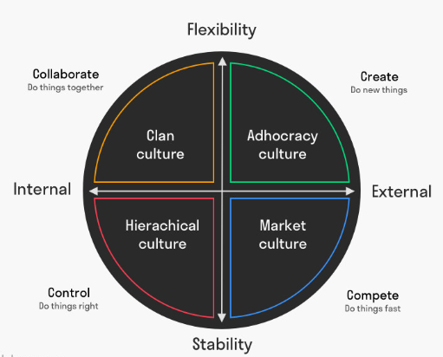
Competing values framework (CVF)
Popular organizational culture assessment model
Developed by Quinn & Cameron (U of Michigan) in early 1980s
Effective organizations typically have one of the following four culture types:
Clan culture
Adhocracy culture
Hierarchical culture
Market culture
Notes:
Content Source: https://www.boomhogeronderwijs.nl/media/8/download_pdf_culture_assessment_workbook.pdf
Images: https://www.toolshero.com/leadership/competing-values-framework/

Slide 15
Competing values framework (CVF)
The four cultures differ along two key dimensions:
Internal focus (well-being of people within the organization)
vs
external focus (focus is on customers, suppliers, external environment)
Preference for structure
vs
Preference for flexibility
(video)
Notes:
Content Source: https://www.boomhogeronderwijs.nl/media/8/download_pdf_culture_assessment_workbook.pdf
Images: https://www.toolshero.com/leadership/competing-values-framework/

Slide 16
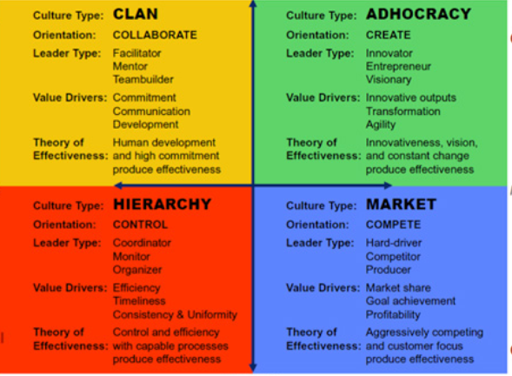
CVF culture types
(video)
Notes:
Sources:
http://4.bp.blogspot.com/-2k_y2i_HVqA/UhNVpcGWiKI/AAAAAAAAAEw/xHnXeJZMyhA/s640/CompetingValues2.jpg
https://www.thercfgroup.com/files/resources/an_introduction_to_the_competing_values_framework.pdf

Slide 17

implementing the Competing Values Framework
What is the dominant culture in my organization (project team)?
Is it a strong culture or a weak culture?
Does the dominant culture align with the company’s objectives, customer’s objectives, external environment?
What are the differences between the existing culture and the desired culture?
Project managers work with different stakeholders: organization, project team, customer/sponsor, supplier, etc. – - What are their dominant cultures and how might that impact the project?
Notes:
Sources:
https://halpincompany.com/wp-content/uploads/2014/12/aligned_team-700x320.jpg
https://www.youtube.com/watch?v=_w51HBVV9b8

Slide 18
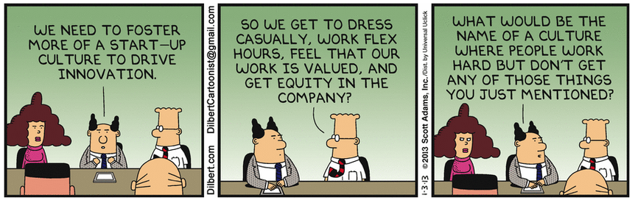
Notes:
Source: https://assets.amuniversal.com/bb9f56d02b5f01300649001dd8b71c47

Slide 19

managing culture on your project team
Develop a ‘culture plan’: Envision/implement your desired culture (align with project goals and strategies)
If possible, acquire team members who have compatible values (ASA Theory*)
Guide new team members through the cultural socialization process
* ASA Theory is described in the assigned readings for this Module…
Notes:
Content Source:
McShane, S.L. & Sheen, S. (2009). Canadian organizational behaviour (7th ed.). Toronto: McGraw-Hill Ryerson.
Smits, K. (2019, March). Blind spot. PMI Network, 23.
Image: https://dailyhr.files.wordpress.com/2014/12/our-team-3.jpg?w=672&h=372&crop=1

Slide 20

Cultural socialization
The process by which individuals learn the values, expected behaviours, and social knowledge necessary to assume their roles
Learning: expectations, power and social dynamics, culture, jargon, job responsibilities
Adjusting: modify expectations, resolve mis-aligned personal and project values, adopt team norms with team members, practise new behaviours
Notes:
Content Source: McShane, S.L. & Sheen, S. (2009). Canadian organizational behaviour (7th ed.). Toronto: McGraw-Hill Ryerson.
Image: http://brewminate.com/wp-content/uploads/2018/02/022818-73-Sociology-Socialization.jpg

Slide 21
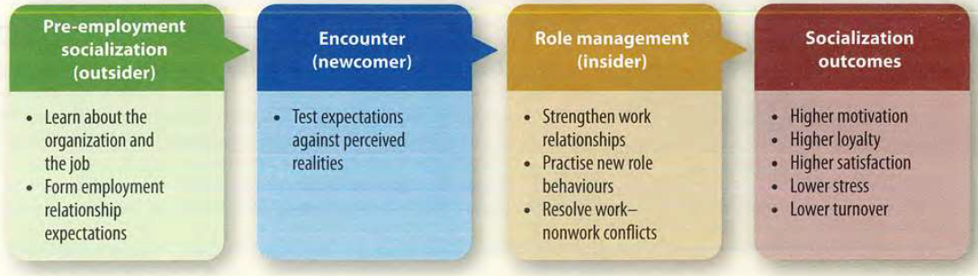
Cultural socialization
Notes:
Content Source:
McShane, S.L. & Sheen, S. (2009). Canadian organizational behaviour (7th ed.). Toronto: McGraw-Hill Ryerson. (p. 344)

Slide 22
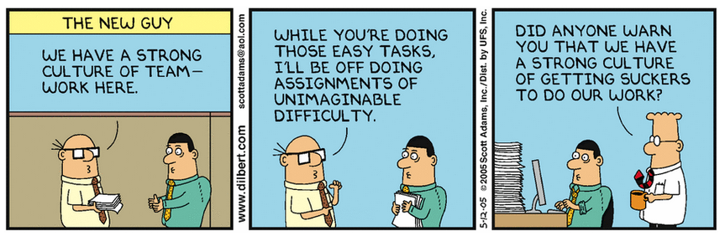
Cultural Socialization of new team members
Notes:
Image: https://dilbert.com/strip/2005-05-12

Slide 23
managing culture on your project team (cont’d)
Regularly communicate project goals & cultural values to the team
Implement activities that will promote your desired culture (establish & align cultural artifacts, ensure espoused and enacted values are the same)
Implement culturally consistent rewards
Team members who don’t have compatible values may quit or you may need to replace them (ASA Theory)
Notes:
Content Source:
McShane, S.L. & Sheen, S. (2009). Canadian organizational behaviour (7th ed.). Toronto: McGraw-Hill Ryerson.
Smits, K. (2019, March). Blind spot. PMI Network, 23.
Image: Image: https://dailyhr.files.wordpress.com/2014/12/our-team-3.jpg?w=672&h=372&crop=1

Slide 24
Compare organizational cultures in these organizations…
Goldman Sachs: (13:20 to 15:30) https://www.youtube.com/watch?v=JWPWaP8kJ-s
Zappos (from 4:57 to 6:27): https://www.youtube.com/watch?v=tFyW5s_7ZWc
Apple: http://www.youtube.com/watch?v=j8hsCx7FFNk
Mars: http://www.youtube.com/watch?v=zMh5roo_I4U
Facebook (2013): https://www.youtube.com/watch?v=V-tSY1h-U3c

